Slide 1
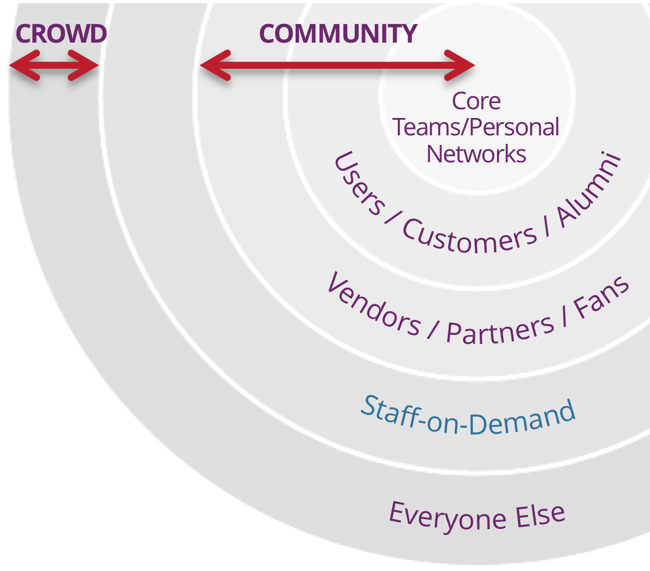


Community and Crowd - The Engine of Exponential Growth!
The Crowd is everyone else outside the community except Staff-on-Demand. They have some awareness of your product, community, MTP or your cause. They are people who could become a member of your community, if you create enough value or attraction for them to opt-in.
Your Community is made up of people who are drawn to and aligned with your Massive Transformative Purpose (MTP). It can include employees, alumni, former team members, partners, and others in some actionable relationship with your MTP.
Community in an ExO is more than a simple transaction. The community creates a center of gravity that attracts and engages stakeholders in a network of relationships, developing over time through peer-to-peer interactions.
TED^{X} is an example of a successful community. The Technology, Entertainment, Design (TED) Conference began in 1984 as a physical event for 1,000 attendees. Today, it’s a global media brand. Since 2009, TED^{X}, its
non-profit volunteer community franchise, has hosted almost 15,000 events. It has created, translated and shared talks garnering over 1 billion views, all of which advances TED‘s MTP to spread ideas.
For ExOs, creating community is a strategic investment of time and leadership that will ultimately foster valuable interactions for all the stakeholders while helping the organization scale.
Tips for Creating Community
Start with your MTP - People form and invest in communities because they share interests, a sense of purpose and a feeling of belonging. In an ExO, your MTP catalyzes the formation, so if no one is showing up, or the wrong people are, rework your MTP.
Find Like-Minded Communities - If an existing organization, start with your customers, employees and partners. For new ventures, ask: ‘What problem spaces does my MTP address?’ and ‘Who else has those problems?’ Reddit, LinkedIn, MeetUp, and existing industry communities are great places to start.
Nurture the Community - Building and maintaining a community takes responsive attention. Maintain trust through actions of the leaders, and how the community is managed.
Create a Platform - automate peer-to-peer engagement. See: Platform Revolution by Parker, Van Alstyne and Choudary.
Harnessing the power of the Crowd
Crowd-funding - Sites like KickStarter or Patreon provide opportunities for people to fund what matters to them.
Crowdsourcing Innovation - Tap into the diverse experience of the crowd. Lego Ideas is a crowdsourcing and co-creating site where Lego enthusiasts post incredible
model designs. Others vote on them, and Lego reviews the best, most popular ideas for a commercial deal! Enthusiasts can then purchase these crowdsourced sets. This community is a meeting ground for Lego’s enthusiast / builders (community), Lego fans (crowd) and customers!
Validating and Supporting Ideas - As you test your hypotheses and validate your business models on the journey to become an ExO, reach out to the crowd to validate your tests, find early adopters and receive other kinds of support for your ideas.
Growing your Community - The crowd is a great recruiting ground. To fuel exponential growth, how will you attract a bigger crowd, and how will you invite them to opt-in?
*See Chapter 3 - The Exponential Organization in Exponential Organizations by Salim Ismail, Michael S. Malone & Yuri van Geest. The Exponential Organizations Master Business Course is a part of the Growth Institute MBD Program. To learn more, visit www.growthinstitute.com/exo Share this tool - info.growthinstitute.com/community-and-crowd-tool
Work licensed under Creative Commons Attribution-NoDerivatives 4.0 International License. By Growth Institute Inc. For a copy of this license, http://creativecommons.org/licenses/by-nd/4.0/ Rev 1.0 2018-07-06 TO LEARN HOW TO USE THIS TOOL, VISIT www.growthinstitute.com/exo

Slide 2
Community and Crowd - Designing your Community
What is your MTP? Who is attracted to your MTP? Are they the right people? (If not, access the MTP Tool - cocktail party exercise to hone your MTP)
Why are you hosting a community? Are you creating a community to reduce cost of customer support? Get feedback on new ideas? Realize your MTP? Generate sales? (Tip - focus on listening before selling!)
What groups are you already interacting with? Customers? Vendors? Employees? LinkedIn or Facebook Communities? Independent user groups? Linking communities to yours may jump-start adoption.
What units of value are being exchanged? Your community will only stay on your platform to offer value to the community if they also receive what they need from the community. Likewise, your company needs something from the community to support investment. (credit for model: Bill Johnston, structure3c.com)
Your community | The Member (i.e. your customer) | Host (your company)
Offers to the Community
Needs from the Community / Company
Community and Crowd - Checklist for Success*
Are we using our MTP to attract and drive community and crowd engagement globally?
Are the MTPs or purpose statements of individual community members in alignment with ours?
Is our community engaged and participating in creating value?
Are we using gamification to increase engagement within the community?
Have we established thresholds and clear expectations for our participating community and crowd members?
Have we attracted first-movers in the field, including those with expertise that is scarce?
Are we receiving product/service feedback and market insight from our community and crowd?
Do we offer performance and engagement incentive prizes to move individuals from crowd into community?
 | The Member (i.e. your customer) | Host (your company)
Offers to the Community | Builders: create and post their design entries Enthusiasts: view, vote and share to other sites; offer feedback and ideas on designs; buy winning sets | 1% net sales on winning sets Prizes, recognition, involvement Community forum Implied: job opportunity?
Needs from the Community / Company | Builders: feedback, votes, recognition, prizes; commercial deal Enthusiasts: belonging; involvement; ideas for their own models; access to new Lego Sets they influenced | Builders AND enthusiasts New product ideas Visibility on other online sites and communities Sales/Purchases Audition talent to recruit
*From Exponential Transformation - The Ultimate Playbook to Evolve Your Business and Change the World for the Better ©2018 by Francisco Palao, Michelle Lapierre and Salim Ismail. Used with permission. ExOFoundation.net
Work licensed under Creative Commons Attribution-NoDerivatives 4.0 International License. By Growth Institute Inc. For a copy of this license, http://creativecommons.org/licenses/by-nd/4.0/ Rev 1.0 2018-07-06 TO LEARN HOW TO USE THIS TOOL, VISIT www.growthinstitute.com/exo

